Slide 1

Federated Feature Selection with
False Discovery Rate Control
Published in:Journal of the Royal Statistical Society Series B: Statistical Methodology (2025)
Authors:Jie Hu, Jiayi Tong, Yang Ning, Cheng Yong Tang, Jason H. Moore, Runze Li, Yong Chen
Notes:
Hello everyone, today I'm excited to present our work titled "Federated Feature Selection with False Discovery Rate Control." This paper has been accepted for publication in the Journal of the Royal Statistical Society Series B, a leading journal in statistical methodology. Our research addresses a critical challenge in modern data science: how to perform effective feature selection across multiple institutions while strictly protecting data privacy and controlling the false discovery rate.

Slide 2

Research Background and Motivation
01 Research Background
02 Core Problem
Under a federated learning framework where raw data cannot be shared, how to accurately screen out universally effective features across sites from high-dimensional distributed data is a leading challenge. It must simultaneously satisfy three core constraints:
•Privacy & Security:Absolutely no leakage of sensitive, individual-level raw data throughout the process.
•Validity:Must strictly control the False Discovery Rate (FDR) to avoid screening out massive false-positive features, ensuring reliable conclusions.
•High Efficiency & Practicality: Must balance computational complexity and communication costs for easy deployment in real-world multi-center collaborative scenarios.
Research Value
Multi-center data can significantly expand sample sizes, enhance statistical power, and help discover more robust scientific laws. It is a key pathway to overcome small-sample study bottlenecks.
Research Challenges
Data silos are prevalent. Due to privacy regulations and commercial barriers, raw data cannot be directly centralized and shared.
03 Limitations of Existing Methods
04 Our Study: Objectives & Contributions
Traditional Centralized Methods (e.g., BHq):
While they can strictly control FDR, they rely on centralizing all raw data, posing extreme privacy leakage risks.
Research Objective: To propose a novel federated feature selection method—Fed-FDR which achieves precise FDR control under strict privacy protection, solving the dilemma of existing methods.
Core Breakthroughs:
1.Theoretically: Proposes the Generalized Mirror Statistic, achieving strict FDR control in a federated framework for the first time.
2.Methodologically: Designs a cross-site feature support swap mechanism, reducing communication costs to theoretical minimums.
3.Practically: Perfectly compatible with cross-site data heterogeneity; computationally efficient and seamlessly deployable in real-world scenarios.
Existing Federated Methods (e.g., Meta-BHq):
They are either overly conservative to control false positives (sacrificing significant screening power), fail to provide strict statistical guarantees, or have computational/communication costs too high for real-world applications.
Notes:
Let's start with the research background. Multi-center data holds immense value for scientific discovery, but it's often trapped in "data silos" due to privacy concerns. This creates a core problem: how to extract meaningful insights without sharing sensitive raw data? Existing methods either risk privacy or lack statistical rigor. Our study introduces Fed-FDR, a new method that breaks this deadlock. Theoretically, we propose a generalized mirror statistic for FDR control. Methodologically, we design an efficient feature support exchange mechanism. Practically, our method is robust to data heterogeneity and easy to implement.

Slide 3
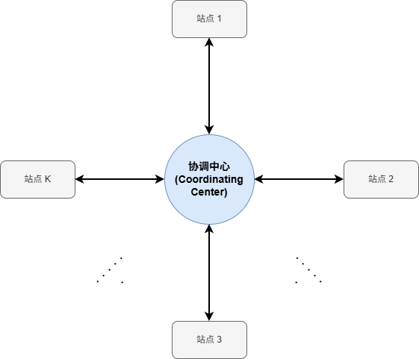

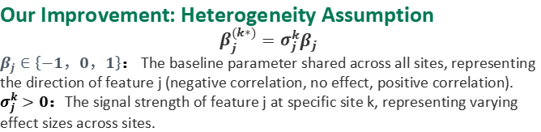
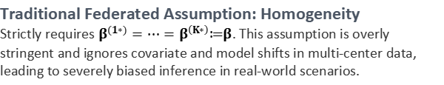
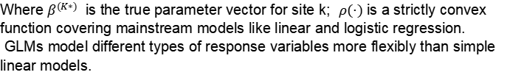

Federated High-Dimensional Generalized Linear Model and Heterogeneity Assumption
Federated Setup
Core Research Objective
Assume data is distributed across K sites. Each site k observes n independent and identically distributed samples ($y_{ki​},{\text{x}}_{ki}$​), where the feature dimension is high-dimensional ${\text{x}}_{ki}​∈R^{p}.$
Without leaking raw data, accurately screen out the significant feature support set shared across all sites through federated collaboration, and conduct valid statistical inference and hypothesis testing.
High-Dimensional Generalized Linear Model for Each Site
Where $β^{(K∗)}$ is the true parameter vector for site k; $ρ(·)$is a strictly convex function covering mainstream models like linear and logistic regression.
GLMs model different types of response variables more flexibly than simple linear models.
Breakthrough: Assumption A1 (Heterogeneity)
Our Improvement: Heterogeneity Assumption
$$β_{j}^{(k∗)}=σ_{j}^{k}β_{j}$$
$β_{j}∈\left\{−1，0，1\right\}$： The baseline parameter shared across all sites, representing the direction of feature j (negative correlation, no effect, positive correlation).
$σ_{j}^{k}>0$：The signal strength of feature j at specific site k, representing varying effect sizes across sites.
Traditional Federated Assumption: Homogeneity
Strictly requires $β^{(1∗)}=⋯=β^{\left(K∗\right)}≔β$. This assumption is overly stringent and ignores covariate and model shifts in multi-center data, leading to severely biased inference in real-world scenarios.
It assumes all sites share a baseline "direction" (a feature is either important everywhere or nowhere), but each site can have its own unique "intensity." This allows for varying effect sizes across sites while ensuring all sites share a common feature support set $S_{1}=\{j∈\left\{1,⋯,p\right\}\left|β_{j}≠0\}\right.$
Notes:
Our work is built upon a federated high-dimensional GLM framework. We assume data is distributed across K sites, and our goal is to find the common set of important features.
A key innovation is our heterogeneity assumption. Unlike traditional federated learning that assumes all sites have identical parameters, we relax this to allow for varying effect sizes across sites. This is crucial because real-world data from different hospitals or institutions is never perfectly homogeneous.
This setting ensures that while effects may differ in strength, we are still identifying a core set of features that are relevant across all sites.

Slide 4
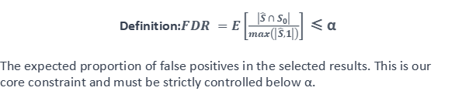
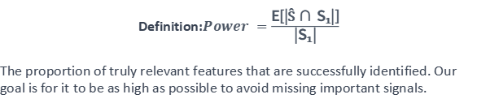


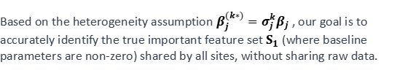
Objectives & Constraints
Core Target: Identify the True Shared Feature Support Set Based on the heterogeneity
Metric 1: Statistical Power — "No Misses"
Definition:$Power =\frac{\text{E}\text{[|Ŝ ∩ }\text{S}\text{₁|]}}{\text{|}\text{S}\text{₁|}}$
The proportion of truly relevant features that are successfully identified. Our goal is for it to be as high as possible to avoid missing important signals.
Based on the heterogeneity assumption $β_{j}^{(k∗)}=σ_{j}^{k}β_{j}$, our goal is to accurately identify the true important feature set $S_{1}$ (where baseline parameters are non-zero) shared by all sites, without sharing raw data.
Mathematical Definition: $S_{1}=\{j∈\left\{1,⋯,p\right\}\left|β_{j}≠0\}\right.$
The set of all truly effective features.
Metric 2: False Discovery Rate (FDR) — "No Errors"
Definition:$FDR =E\left[\frac{\left|\hat{S}∩S_{0}\right|}{max\left(\left|\hat{S},1\right|\right)}\right]$≤ α
The expected proportion of false positives in the selected results. This is our core constraint and must be strictly controlled below α.
Baseline Setup:$p₁=|S₁|$(True effective features), $p₀=p−p₁$(Noise features), $Ŝ$(Algorithm selection results). We need to get $Ŝ$ as close as possible to the true set $S₁$.
Difficulty with Traditional Methods
Traditional methods often face a dilemma: increasing power to include more true signals inevitably introduces more false positives, leading to FDR inflation. Conversely, strictly controlling FDR can significantly sacrifice power.
The Breakthrough:
The proposed Generalized Mirror Statistic simultaneously achieves strict FDR control and significantly superior statistical power under federated heterogeneity, solving the traditional dilemma.
Notes:
Our research objectives are clear and dual-faceted. We aim to maximize statistical power, which means identifying as many true signals as possible, while simultaneously controlling the False Discovery Rate (FDR), ensuring we don't make too many mistakes. This is a classic trade-off in statistics. Traditional methods often fail to balance both effectively. The core breakthrough of our work is the Generalized Mirror Statistic, which for the first time in a federated setting, achieves both strict FDR control and high statistical power, solving this fundamental dilemma.

Slide 5

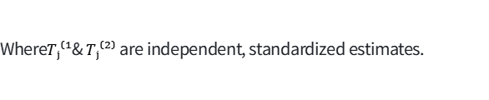
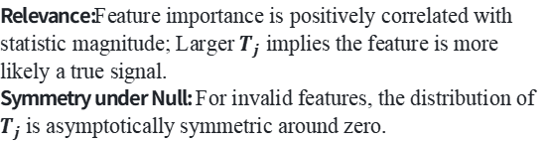
Preceding Theory: Mirror Statistic(Dai et al., 2023a)
Base Model Selection for Different Dimensions:
Application Scenarios | Dimensional Features | Recommended Base Model
Medium Dimension | p/n → κ ∈ (0,1) | Maximum Likelihood Estimation (MLE)
Ultra-high Dimension | p ≫ n | Debiased Lasso
Two Core Assumptions (Core Properties)
Relevance:Feature importance is positively correlated with statistic magnitude; Larger $T_{j}$​implies the feature is more likely a true signal.
Symmetry under Null: For invalid features, the distribution of $T_{j}$ is asymptotically symmetric around zero.
How to generate two independent estimators:
Method A: Data Splitting
Randomly split the dataset into two parts and fit the model on each part separately to get independent estimates.
Method B: Gaussian Mirroring
Inject Gaussian noise into features to create a "mirror" pair without splitting data, ideal for small sample sizes.
General Form
Where$Tⱼ⁽¹$& $Tⱼ⁽²⁾$ are independent, standardized estimates.
Key Limitations
1.Single-Center Only:All methods require centralized raw data, making them incompatible with privacy-isolated federated learning.
2.Homogeneity Assumption:Assumes identical model parameters across all samples, failing to handle cross-site heterogeneity.
The Mirror Statistic is a flexible framework, not a fixed formula. It works with any model that can produce two independent standardized estimates for each feature.
Notes:
Our work builds upon the Mirror Statistic proposed by Dai et al. in 2023. This framework relies on two key properties: relevance and symmetry under the null hypothesis. The general form combines two independent estimates for each feature. While powerful, the original mirror statistic has two major limitations: it's designed for a single center and assumes data homogeneity. These limitations make it unsuitable for real-world multi-center federated learning scenarios, which is exactly the gap our work aims to fill.

Slide 6

Limitations & Solutions in Federated Settings
Problem 1: Lasso Estimation is Biased in High Dimensions
Solution and Application in This Paper
In high-dimensional data (p≫n), we use L1-regularized Lasso for feature selection. However, it introduces non-negligible estimation bias, causing the coefficient estimates to no longer follow an asymptotic normal distribution.
Since zero symmetry is the cornerstone of the mirror statistic, once normality is violated, zero symmetry no longer holds, and FDR control fails.
Solution: Introduce the desparsified Lasso (Dai et al., 2023)for debiasing to restore the asymptotic normality and zero symmetry.
Extension: Combine it with an original cross-site feature exchange mechanism to achieve unbiased estimation in federated high-dimensional scenarios.
Problem 2: Original Mirror Statistic Cannot Handle Federated Heterogeneity
This Study's Improvement: Generalized Mirror Statistic
Data isolation in federated learning makes single-center splitting impossible. Worse,model shifts(varying signal strength of features across sites) are prevalent.
The strong homogeneity assumption of the original mirror statistic is invalid and cannot handle this heterogeneous structure.
We propose a Generalized Mirror Statistic that adapts to federated heterogeneous environments. Uses the product sign of estimates from different sites (s and t) to maintain symmetry, replacing manual data splitting. It uses a non-negative monotonic function f(x,y) to fuse varying signal strengths.
We will now explore the mathematical form of the generalized mirror statistic and the cross-site feature support exchange mechanism.
Notes:
We identified two main problems. First, in high-dimensional settings, Lasso introduces bias that breaks the normality assumption required for the mirror statistic. To fix this, we use a desparsified Lasso technique. Second, the original mirror statistic cannot handle the inherent heterogeneity and data isolation of federated learning. To address this, we propose a Generalized Mirror Statistic and a novel cross-site feature support exchange mechanism, which we will detail next.

Slide 7

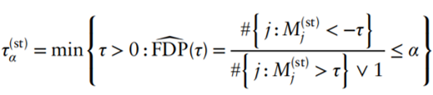

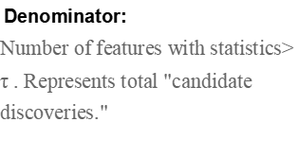
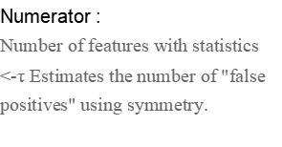
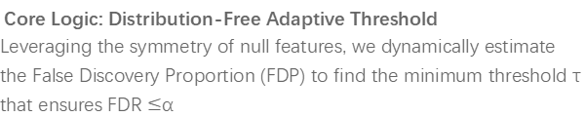
Definition: Generalized Mirror Statistic
For any pair of sites (s,t), the statistic for feature j fuses sign and intensity:
Formula defination:Generalized Mirror Statistic
Core Logic: Distribution-Free Adaptive Threshold
Leveraging the symmetry of null features, we dynamically estimate the False Discovery Proportion (FDP) to find the minimum threshold τ that ensures FDR $≤$α
Fusion Component: Heterogeneity Compatibility
Fuses multi-site estimates into one statistic. The function adapts to varying signal strengths while satisfying symmetry, exchangeability, and unbiasedness.
Threshold Calculation (Formula 3):
Sign Term: Zero-Feature Symmetry
Extracts the sign of the product of estimates from two sites. For null features, positive/negative probabilities are 50%, ensuring strict zero distribution symmetry.
What is τ:
Candidate threshold to be searched. We start from 0 and increase gradually to find the minimum value that satisfies the condition.
Numerator :
Number of features with statistics $<$-τ Estimates the number of "false positives" using symmetry.
Optimal Choice: f(x, y) = x + y (Asymptotically Optimal)
Recommended by Dai et al. (2023a). Computationally simple and proven to have the highest statistical power, balancing cost and performance.
Denominator:
Number of features with statistics$>$ τ . Represents total "candidate discoveries."
Final Selection:
$${\hat{S}}^{(s,t)}=\{J:M_{j}^{\left(s,t\right)}>τ_{α}^{\left(s,t\right)}\}$$
Privacy Compliance Advantage
Only model coefficient estimates are exchanged throughout the process, without involving any raw individual data. This perfectly satisfies the requirements of data privacy protection and compliance.
For multi-site scenarios with K>2, we further propose an aggregation strategy that significantly improves statistical power while ensuring FDR control.
Notes:
Here is the definition of our Generalized Mirror Statistic. It has two parts: a sign component and a fusion component. The sign component leverages the natural independence between different sites to ensure the crucial symmetry property for null features. The fusion component combines information from different sites, allowing us to handle heterogeneity. We choose a simple sum function for optimal performance. Critically, our method only exchanges model coefficients, not raw data, ensuring full compliance with privacy regulations.

Slide 8



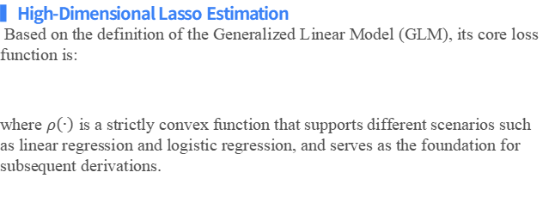
Desparsified Lasso
Theoretical Foundation: High-Dimensional GLM & Lasso Estimation
▍Lasso Parameter Estimation:When feature dimension p ≫ sample size n, L1 regularization is used for sparse estimation:
Feature selection is achieved through L1 penalization, which effectively addresses the problem of model overfitting in high-dimensional spaces and identifies important variables.
▍High-Dimensional Lasso Estimation
Based on the definition of the Generalized Linear Model (GLM), its core loss function is:
where $ρ\left(∙\right)$ is a strictly convex function that supports different scenarios such as linear regression and logistic regression, and serves as the foundation for subsequent derivations.
Core Conflict: Lasso Bias & Classic Debiasing
Solution: Desparsified Lasso (2014)
Corrects the bias by subtracting the gradient of the L1 regularization term, restoring asymptotic normality.
Restores normality for valid statistical inference, but faces new challenges in federated learning.
Existing Defect: Shrinkage Bias
L1 regularization introduces shrinkage bias, causing coefficient estimates to lose asymptotic normality. This breaks the zero symmetry of the mirror statistic and invalidates FDR control.
❌ Three Critical Issues in Federated High-Dimensional Settings
High Cost: it requires transmitting the complete P-dimensional coefficient vector to the central node, resulting in exorbitant communication costs. This massive data transmission creates a severe communication bottleneck, running counter to the original efficiency-driven purpose of federated learning.
Infeasibility: Constructing the inverse Hessian matrix requires P node-wise regressions, which is computationally infeasible in high dimensions and renders the underlying assumptions unrealistic.
Sparsity Loss: the coefficients become entirely non-zero after debiasing, stripping away Lasso's core capability of sparse selection.
Proposed:Cross-Site Feature Support Exchange Mechanism(to reduce computation/communication costs while maintaining debiasing).
Notes:
To implement our method, we use the desparsified Lasso. Lasso is a standard tool for high-dimensional feature selection, but it introduces bias. The desparsified Lasso corrects this bias, restoring the normality needed for our mirror statistic. However, applying this in a federated setting presents new challenges: infeasible computation, loss of sparsity, and high communication costs. Our solution is a novel cross-site feature support exchange mechanism, which we will explain next, designed to overcome all three problems simultaneously.

Slide 9
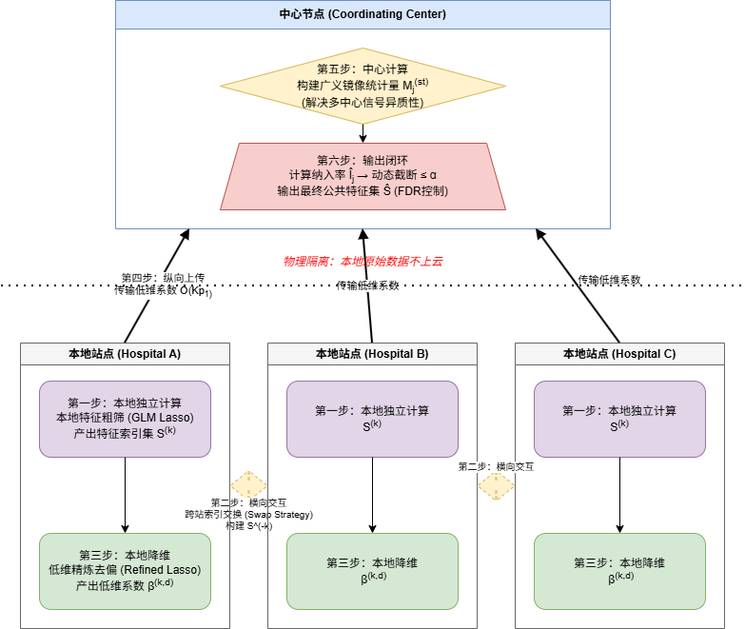
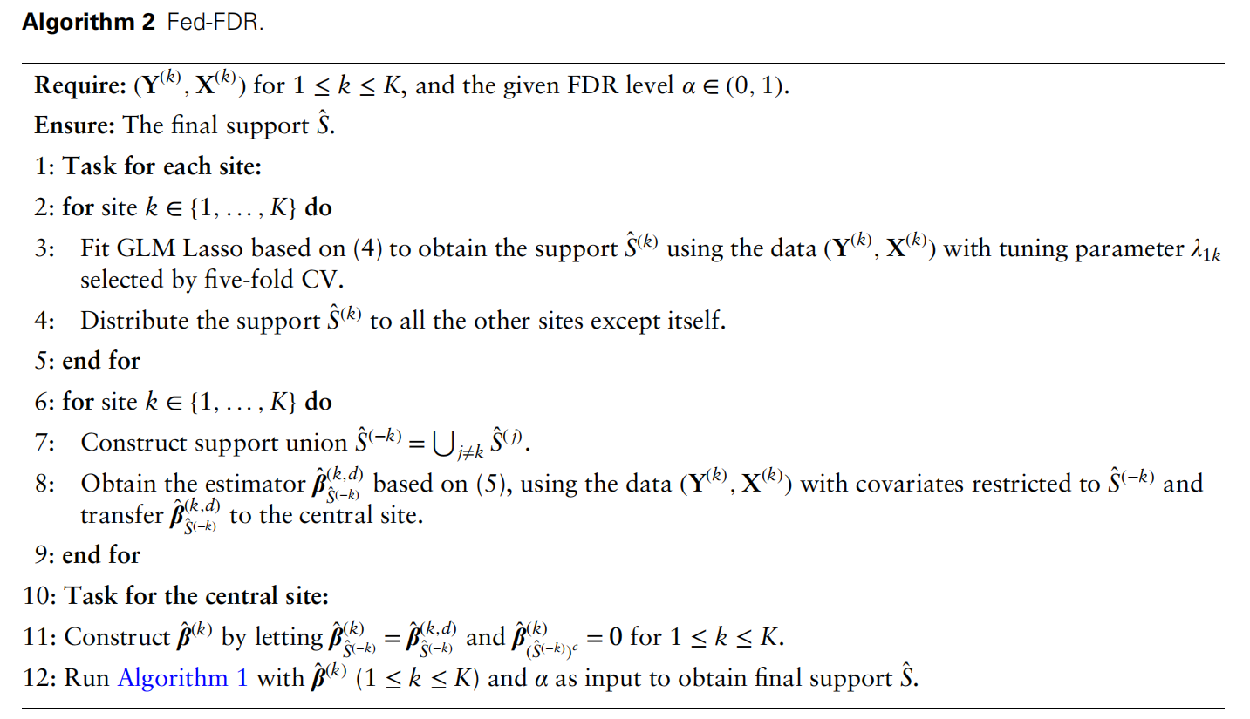
Cross-Site Local Exchange (Algorithm 2)
The Swap Strategy: Solving the Legitimacy Problem of FDR Control
Notes:
This slide illustrates our core algorithm, the cross-site local exchange, or "swap strategy." The key idea is simple yet powerful: each site uses features selected by other sites to perform its debiasing step. This cleverly separates the selection and inference steps, solving the statistical validity problem. As a side benefit, it drastically reduces both computational complexity and communication costs. Instead of dealing with the full high-dimensional space, we work in a much smaller space defined by the union of features selected across all sites.

Slide 10
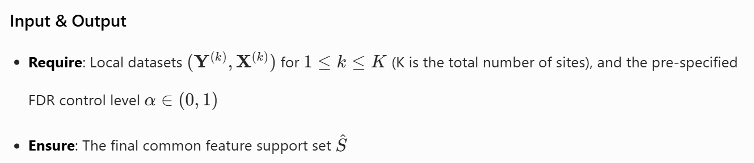
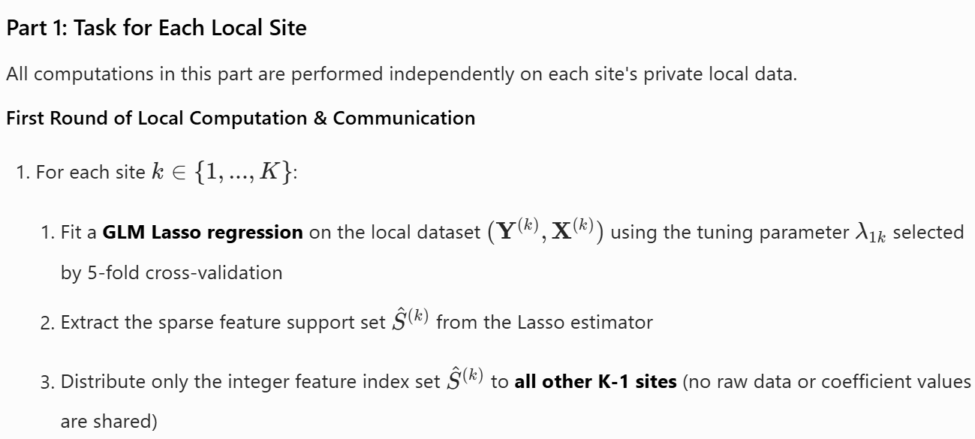
Cross-Site Local Exchange (Algorithm 2)
The Swap Strategy: Solving the Legitimacy Problem of FDR Control
Notes:
This slide illustrates our core algorithm, the cross-site local exchange, or "swap strategy." The key idea is simple yet powerful: each site uses features selected by other sites to perform its debiasing step. This cleverly separates the selection and inference steps, solving the statistical validity problem. As a side benefit, it drastically reduces both computational complexity and communication costs. Instead of dealing with the full high-dimensional space, we work in a much smaller space defined by the union of features selected across all sites.

Slide 11
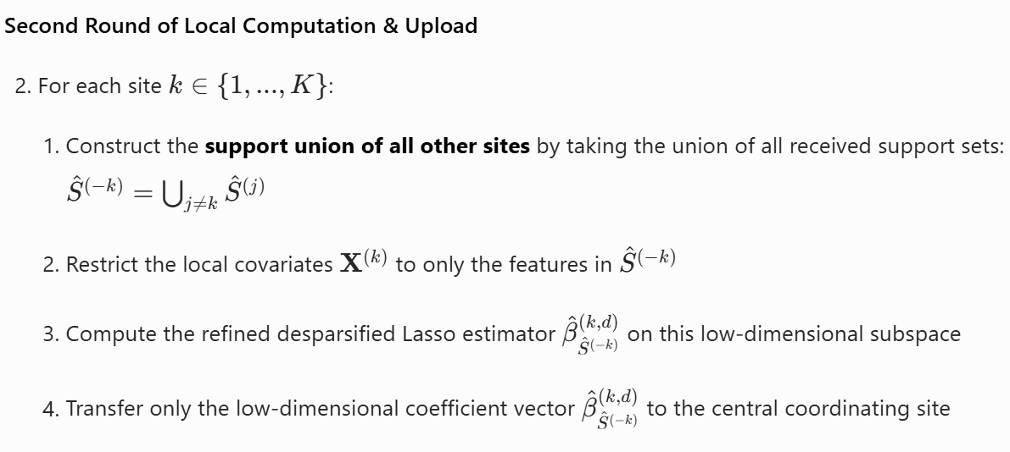
Cross-Site Local Exchange (Algorithm 2)
The Swap Strategy: Solving the Legitimacy Problem of FDR Control
Notes:
This slide illustrates our core algorithm, the cross-site local exchange, or "swap strategy." The key idea is simple yet powerful: each site uses features selected by other sites to perform its debiasing step. This cleverly separates the selection and inference steps, solving the statistical validity problem. As a side benefit, it drastically reduces both computational complexity and communication costs. Instead of dealing with the full high-dimensional space, we work in a much smaller space defined by the union of features selected across all sites.

Slide 12
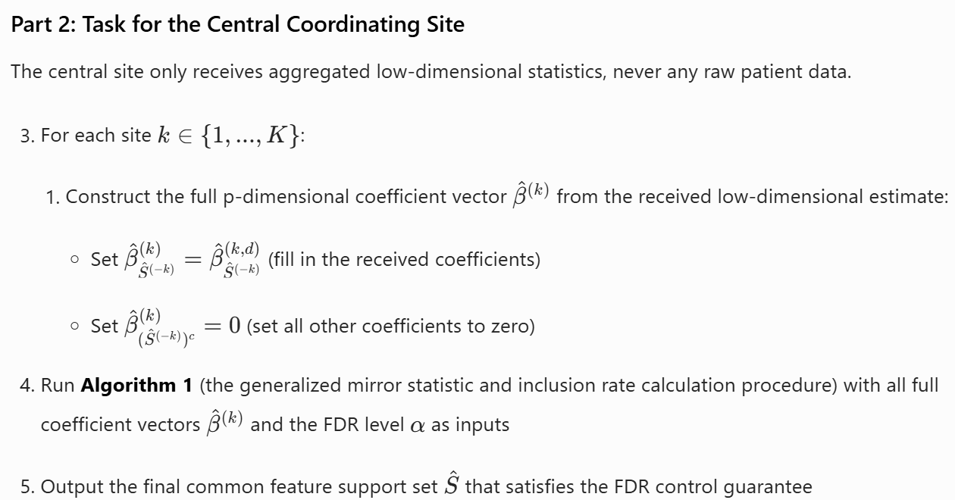
Cross-Site Local Exchange (Algorithm 2)
The Swap Strategy: Solving the Legitimacy Problem of FDR Control
Notes:
This slide illustrates our core algorithm, the cross-site local exchange, or "swap strategy." The key idea is simple yet powerful: each site uses features selected by other sites to perform its debiasing step. This cleverly separates the selection and inference steps, solving the statistical validity problem. As a side benefit, it drastically reduces both computational complexity and communication costs. Instead of dealing with the full high-dimensional space, we work in a much smaller space defined by the union of features selected across all sites.

Slide 13
The Swap Strategy
Addressing the Validity Issue of FDR Control
Substantially Reducing Computational Complexity
Significantly Decreasing Communication Costs
Problem 2: Traditional methods require p node-wise regressions, leading to a computational explosion in high dimensions.
Main Cause: The high-dimensional Hessian matrix is singular and cannot be directly inverted.
Solution: The low-dimensional matrix is full-rank and can be directly inverted, drastically reducing the computational complexity from O(p²) to O(p₁²).
Problem 3: The estimators become non-sparse after debiasing, which requires transmitting the complete p-dimensional coefficient vector.
Solution: Transmit only the feature indices and the low-dimensional coefficients, reducing the communication cost to O(Kp₁).
Problem 1: Selecting features and performing inference within a single site leads to severe selection bias, destroying zero-symmetry and causing FDR to spiral out of control.
Main Cause: The bias stems from the fact that the selection data and inference data originate from the same source.
Solution: Perform inference using the union of features from other independent sites, thereby achieving complete independence between feature selection and statistical inference.
Notes:
Let's recap the benefits of our swap strategy. First, it solves the fundamental statistical problem of selection bias by ensuring independence between the features used for selection and inference.
Second, it drastically reduces computational complexity by working in a low-dimensional space, making the algorithm feasible even for very high p.
Third, it minimizes communication costs by only sharing a small set of feature indices and coefficients, which is crucial for real-world deployment.

Slide 14
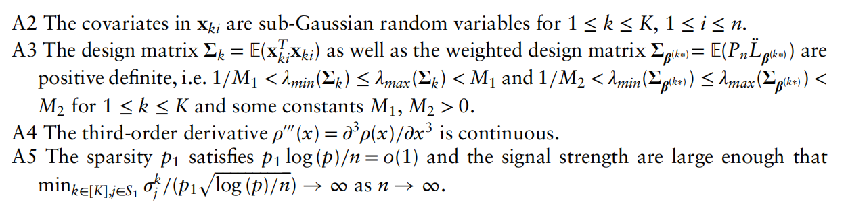

Assumptions A2-A5
Assumption No. | Mathematical Statement | Corresponding Algorithmic Meaning
A2 | Covariatesxᵏᵢfor all sites are sub-Gaussian random variables. | Ensures that the concentration inequality for Lasso estimation holds, preventing extreme outliers from causing estimation failure.
A3 | The design matrix and the weighted Hessian matrix are positive definite, with strictly bounded eigenvalues. | Ensures the Hessian matrix is invertible during low-dimensional debiasing, a core prerequisite for the refined desparsified Lasso to be computable.
A4 | The third-order derivative of the GLM link function ρ is continuous. | Ensures the remainder term of the Taylor expansion is controllable, allowing the debiasing operation to effectively eliminate the shrinkage bias of Lasso.
A5 | Sparsity: Min signal strength:. | Ensures that the initial Lasso screening can include all true features, preventing true signals from being drowned out by noise.
Notes:
To prove the theoretical guarantees of our method, we rely on several standard assumptions. A2 ensures covariates are well-behaved. A3 ensures the mathematical operations in debiasing are valid. A4 is a regularity condition on the GLM link function. Finally, A5 is a sparsity condition, which is standard in high-dimensional statistics, ensuring that the true signals are strong enough to be detected by the initial Lasso step. These assumptions are mild and commonly used in the literature.

Slide 15

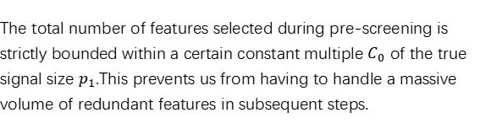



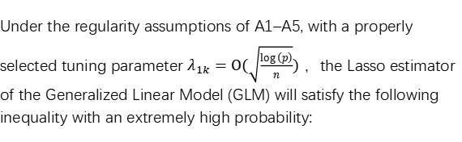
Proposition 2：Lasso Deterministic Screening
In the first step of the algorithm, we use local Lasso for pre-screening. Is this step reliable enough? Can it eliminate a large number of irrelevant features while absolutely guaranteeing that no true features genuinely useful for prediction are missed?
Mathematical Conclusion: Theoretical Guarantees of Proposition 2
Core Insights: Why Is This Conclusion So Critical?
Under the regularity assumptions of A1–A5, with a properly selected tuning parameter $λ_{1k}=Ο(\sqrt{\frac{\log\left(p\right)}{n}})$ ，the Lasso estimator of the Generalized Linear Model (GLM) will satisfy the following inequality with an extremely high probability:
Reason 1: High Probability of Containing All True Signals
$$S_{1}⊂{\hat{S}}^{(K)}$$
Lasso contains all truly relevant features with a probability approaching 1 .This ensures that subsequent debiasing and aggregation steps will not completely fail due to omissions during the initial screening stage.
Reason 2: Controllable Number of Screened Features
$$\left|{\hat{S}}^{(K)}\right|≤C_{0}P_{1}$$
Where:$S_{1}$ is the set of truly relevant features; ；${\hat{S}}^{(K)}$ is the Lasso pre-screening result of site k ；$p_{1}=\left|S_{1}\right|$ is the number of true features. This implies that as the sample size increases, the probability approaches 1.
The total number of features selected during pre-screening is strictly bounded within a certain constant multiple $C_{0}$ of the true signal size $p_{1}$.This prevents us from having to handle a massive volume of redundant features in subsequent steps.
Notes:
接下来我们看第一个核心命题，它回答了一个最基础的问题：我们第一步用Lasso做本地初筛，靠不靠谱？这个命题告诉我们两件事：第一，Lasso几乎不会漏掉任何真正相关的特征；第二，它也不会选出太多没用的噪声，选出的总数大概是真实特征数的几倍。这就为我们后面把高维问题降成低维问题打下了基础。

Slide 16
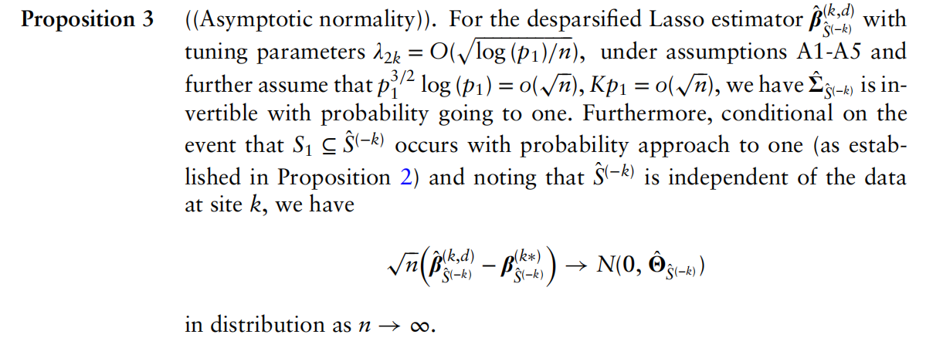
Proposition 3: Asymptotic Normality
Proves the validity of low-dimensional debiasing strategy, laying a mathematical foundation for FDR control
After low-dimensional debiasing, do our coefficient estimates satisfy the rigorous mathematical conditions for valid FDR control?
Mathematical Conclusion: Proposition 3
Core Value: A Necessary Precondition for FDR Control
Under the assumption that the regularity conditions A1–A5 are satisfied, the estimator obtained through the low-dimensional refined desparsified Lasso method possesses the following asymptotic properties:
Symmetry of Null Features
The coefficient estimates of null features asymptotically follow a normal distribution centered at zero, perfectly satisfying the core requirement of "symmetry" for the generalized mirror statistic. This provides the theoretical guarantee for effectively controlling the FDR and establishes the foundational validity of the entire algorithm.
Computational Efficiency
By operating solely in the low-dimensional space after initial Lasso screening, the Hessian matrix is invertible with high probability, and the computational complexity drops from O(p²) to O(p₁²), achieving a drastic leap in efficiency through dimensionality reduction.
This proposition theoretically guarantees that, even in high-dimensional settings, our low-dimensional debiased strategy can still yield estimators with asymptotic normality, which serves as the cornerstone for the validity of statistical inference.
Notes:
Proposition 3 is the key to the validity of our entire method. It proves that our debiased estimates are asymptotically normal. This is essential because the mirror statistic relies on the symmetry of the null distribution around zero, which is a property of the normal distribution. This proposition provides the mathematical guarantee that our FDR control is valid. Additionally, it confirms the computational efficiency of our approach, as we only need to invert a low-dimensional matrix.

Slide 17
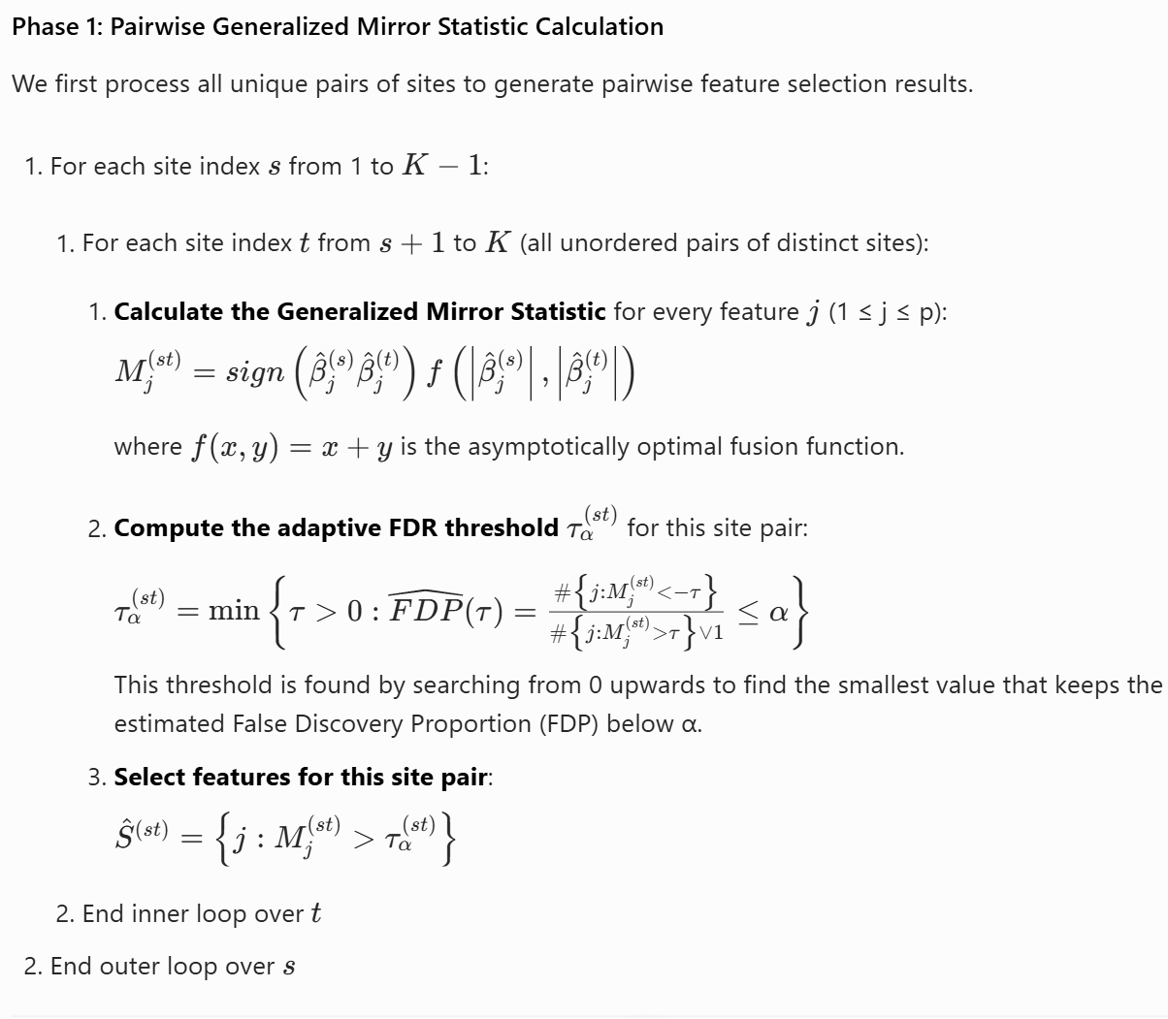
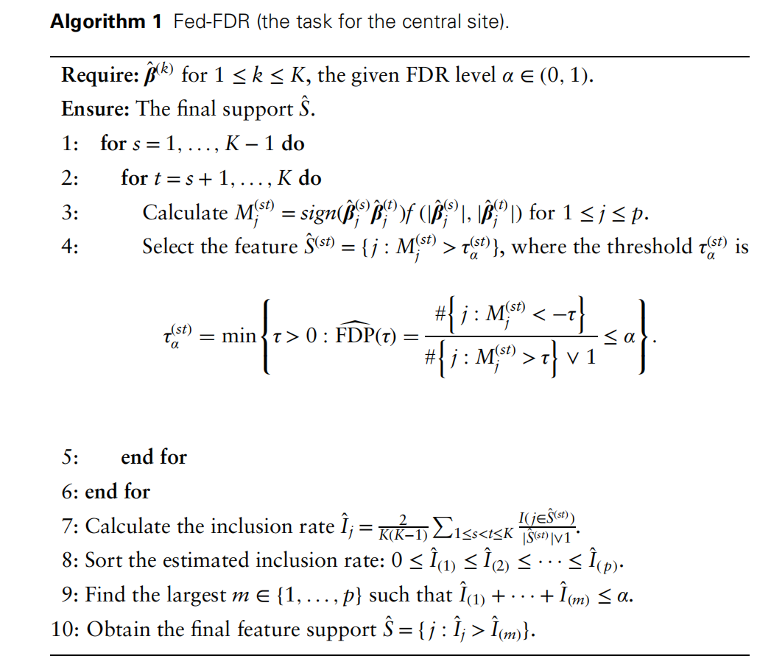
Algorithm 1：Final Aggregation Step of Federated Feature Selection
This is the exact formal procedure executed exclusively at the central coordinating site, which takes the low-dimensional coefficient estimates from all local sites as input and outputs the final feature support set with guaranteed FDR control.
Notes:
Algorithm 1 describes the final aggregation step performed at the central server. It takes the debiased estimates from all sites as input. For every pair of sites, it calculates the generalized mirror statistic and determines a threshold to control FDR for that pair. It then calculates an "inclusion rate" for each feature, representing how often it was selected across all pairs. Finally, it uses this inclusion rate to select the final set of features that controls the overall FDR across all sites. This multi-pair aggregation strategy enhances the robustness and power of the final result.

Slide 18

Algorithm 1：Final Aggregation Step of Federated Feature Selection
Notes:
Algorithm 1 describes the final aggregation step performed at the central server. It takes the debiased estimates from all sites as input. For every pair of sites, it calculates the generalized mirror statistic and determines a threshold to control FDR for that pair. It then calculates an "inclusion rate" for each feature, representing how often it was selected across all pairs. Finally, it uses this inclusion rate to select the final set of features that controls the overall FDR across all sites. This multi-pair aggregation strategy enhances the robustness and power of the final result.

Slide 19

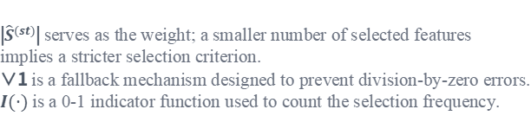

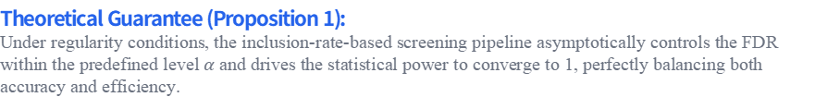
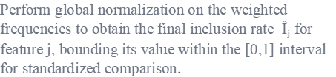
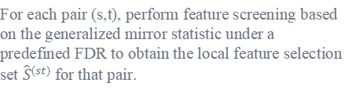
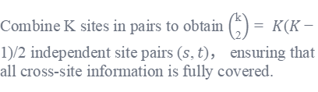
Inclusion Rate
Why do we need the inclusion rate?
Calculation Flow of the Inclusion Rate
1. Eliminating Random Fluctuations from Single-Pair Combinations
STEP 1. Generate Full Cross-Site Pairs
STEP 2. Feature Screening for Individual Pairs
Combine K sites in pairs to obtain $\left({k \atop 2}\right)= K(K−1)/2$ independent site pairs $(s,t)$， ensuring that all cross-site information is fully covered.
For each pair (s,t), perform feature screening based on the generalized mirror statistic under a predefined FDR to obtain the local feature selection set ${\hat{S}}^{(st)}$for that pair.
Single-pair combinations are highly susceptible to local noise interference, leading to unstable results.But aggregating the full pairwise combination results across K sites effectively smooths out random errors and enhances screening robustness.
STEP 3. Weighted Frequency Counting for Individual Features
STEP 4. Normalization to Obtain the Final Inclusion Rate
2. Distinguish signal from noise
Count the selection status of feature j across all pairs, and weight it by the size of the selection set for each pair to reflect the confidence of the results.
Perform global normalization on the weighted frequencies to obtain the final inclusion rate $Îⱼ$for feature j, bounding its value within the [0,1] interval for standardized comparison.
Null (irrelevant) features are selected only by chance, making simple frequency counting inadequate for measuring confidence.But the inclusion rate of true signals approaches 1 while that of noise approaches 0, providing exceptional discriminative power.
|${\hat{S}}^{(st)}$| serves as the weight; a smaller number of selected features implies a stricter selection criterion.
∨1 is a fallback mechanism designed to prevent division-by-zero errors.
$I(·)$ is a 0-1 indicator function used to count the selection frequency.
3. Providing a Sorting Basis for Global FDR Control
Final Selection Rule:
Sort the inclusion rates and find the maximum index m that satisfies the cumulative sum $≤α$. The final selected features consist of all features with an inclusion rate higher than the threshold Î(m) ,completing the global screening.
It is difficult to directly and uniformly control the False Discovery Rate (FDR) across multiple sets of independent statistics. But sorting based on the inclusion rate allows a data-driven thresholding approach to strictly lock the global FDR at a predefined level.
Theoretical Guarantee (Proposition 1):
Under regularity conditions, the inclusion-rate-based screening pipeline asymptotically controls the FDR within the predefined level $α$and drives the statistical power to converge to 1, perfectly balancing both accuracy and efficiency.
Notes:
The inclusion rate is a key concept in our aggregation step. It serves three main purposes: it smooths out random fluctuations from individual pairwise comparisons, it provides a clear measure to distinguish true signals from noise, and it allows us to apply a global FDR control criterion. The calculation involves counting how often each feature is selected across all pairs of sites and normalizing this count. Our theoretical guarantee (Proposition 1) ensures that this procedure achieves the desired FDR control and high power.

Slide 20
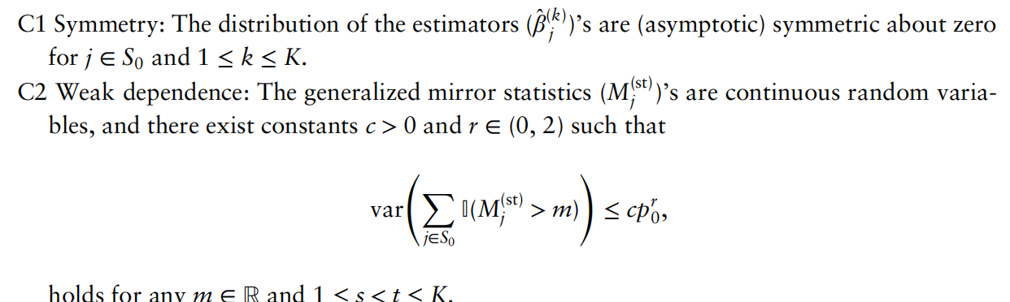
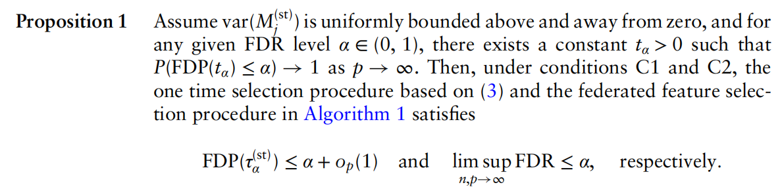
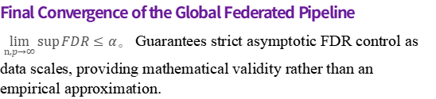
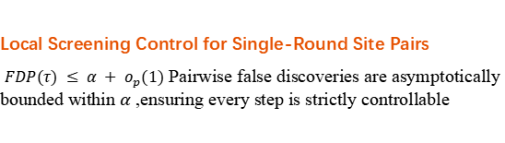
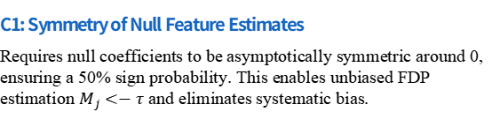
Proposition 1 and the Two Major Conditions
— Why Does This Truncation Guarantee Global FDR Control?
Two Core Regularity Conditions:
Proposition 1 main conclusion：
C1: Symmetry of Null Feature Estimates
Requires null coefficients to be asymptotically symmetric around 0, ensuring a 50% sign probability. This enables unbiased FDP estimation $M_{j}<−τ$ and eliminates systematic bias.
Local Screening Control for Single-Round Site Pairs
$FDP(τ) ≤ α + o_{p}(1)$ Pairwise false discoveries are asymptotically bounded within $α ,$ensuring every step is strictly controllable
C2: Weak Dependence of Mirror Statistics
Requires continuous mirror statistics with bounded variance to prevent false-positive clustering. This guarantees consistent FDP convergence, ensuring stable large-scale inference.
Final Convergence of the Global Federated Pipeline
$\lim_{n,p→∞}{\sup{FDR}≤α}$。 Guarantees strict asymptotic FDR control as data scales, providing mathematical validity rather than an empirical approximation.
Premise :
C1 Symmetry + C2 Weak Dependence → Estimable false positives with controlled fluctuations.
Derivation:
Prop 1 Constraints → Establishes the theoretical foundation for FDR control transitioning from the local to the global level
Results：
Inclusion rate sorting + truncation → Stable global FDR strictly bounded within α。
Notes:
这一页是Fed-FDR能控全局FDR的理论核心。我们只需要两个条件：第一，零特征的系数估计关于0对称，这让我们能精准估算假阳性；第二，镜像统计量弱相关，避免假阳性扎堆。满足这两个条件，命题1就严格证明了：不管是单组站点配对，还是最终的全局纳入率截断，最终的错误发现率都会被控制在预设的α以内，这就是我们方法统计严谨性的根本保障。

Slide 21
Theorem 1: Core Theoretical Guarantee
Conclusion： Under the same assumptions as Proposition 3, the Fed-FDR algorithm achieves a theoretical breakthrough: it ensures strict FDR control at any preset level α, and achieves asymptotically optimal statistical power as the sample size approaches infinity.
Theorem 1’s Double Guarantees :
Logical Closed-Loop: A Complete Chain from Assumptions to Practice
1. Strict FDR Control
For any significance level α ∈ (0,1), as the total sample size nK approaches infinity, the false discovery rate of the algorithm will be strictly limited within the preset threshold, and the bias term converges extremely quickly.
Logical Path
A1-A5 Basic Assumptions (Independent and Identically Distributed / Sparsity) → Proposition 2&3 (Lasso Fidelity and De-biased Symmetry) → Theorem 1 (FDR Controlled + Power Converges to 1).
2. Asymptotic Optimality
Core Value
Under the sparsity assumption, when the feature dimension p grows synchronously with the sample size, the algorithm can identify all true signals with probability 1, achieving the theoretical optimal statistical power.
Breaking the dilemma of traditional federated learning, it proves that the algorithm theoretically balances reliability and effectiveness. Its linear communication and computational complexity make this method highly valuable for engineering applications in high-dimensional data scenarios such as healthcare and finance.
Notes:
这就是我们整个论文最核心的主定理，它把前面所有的假设和命题都串起来了。它告诉我们：Fed-FDR这个方法，在理论上是完全站得住脚的。第一，它能严格控制假发现率，不会选出一堆假阳性特征；第二，它的统计功效会随着样本量增加趋近于1，也就是说几乎能找出所有真正相关的特征。这就解决了传统联邦方法要么控不住FDR，要么功效太低的两难问题。

Slide 22
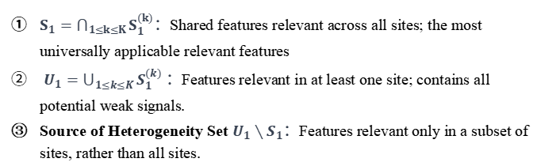
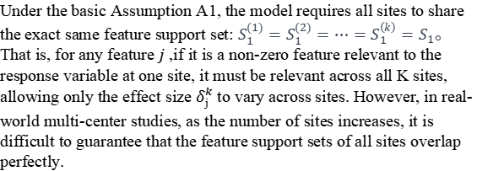
4.1 Cross-Site Support Set Heterogeneity
If the "related features" of different sites are not completely the same, will our method still be applicable?
Problem：
$S_{1}=\bigcap_{1≤k≤K}{S_{1}^{(k)}}$：Shared features relevant across all sites; the most universally applicable relevant features
$U_{1}=\bigcup_{1≤k≤K}{S_{1}^{(k)}}$ ：Features relevant in at least one site; contains all potential weak signals.
Source of Heterogeneity Set $U_{1}∖S_{1}$：Features relevant only in a subset of sites, rather than all sites.
Under the basic Assumption A1, the model requires all sites to share the exact same feature support set: $S_{1}^{(1)}=S_{1}^{(2)}=⋯=S_{1}^{\left(k\right)}=S_{1}。$ That is, for any feature $j ,$if it is a non-zero feature relevant to the response variable at one site, it must be relevant across all K sites, allowing only the effect size $δ_{j}^{k}$to vary across sites. However, in real-world multi-center studies, as the number of sites increases, it is difficult to guarantee that the feature support sets of all sites overlap perfectly.
Target A: Lock Core Commonalities
Select only features recognized by the majority of sites.FDR increases slightly, while power remains at 100%. Reason: Strong signals always selected, few weak signals mixed in.
Target B: Mine Potential Signals
Include features recognized even by a minority of sites. FDR is strictly controlled, while power drops slightly. Reason: Prevents missing weak signals while strictly controlling false positive interference.
This section’s perpose：
In the realistic scenario of heterogeneous support sets, we define two core research objectives and evaluate Fed-FDR's FDR control and statistical power under each objective.
Target type | defination | Scientific Significance
Objective A: Find a set of common feature S₁ | Intersection of features important to all K sites | Used for developing national clinical guidelines and industry standards — must be absolutely reliable with no false positives.
Objective B: Find the full set of features U₁ | Union of features important to ≥1 site | Used for exploratory research and biomarker screening — cannot afford to miss any potentially useful signals.
Fed-FDR Core Advantages ：
No need to pre-specify the degree of heterogeneity; the algorithm automatically adapts.Provides clear statistical performance boundaries with interpretable results.A single algorithm flexibly switches between "identifying commonalities" and "identifying the full set," balancing research efficiency and scientific rigor.Fed-FDR can accurately tackle this "heterogeneity" challenge without pre-specifying data distributions.
Notes:
这一页我们讨论一个非常现实的问题：如果不同医院的相关特征不完全一样，我们的方法还能用吗？首先我们定义两个概念：交集是所有医院都认可的共性特征，也是最稳健的核心信号；并集是所有可能相关的特征，包含了所有潜在信号。我们的方法可以灵活适配这两个不同的研究目标，但性能会有不同的变化。如果你想找最稳健的共性特征，那么我们的方法能保证100%找出这些特征，不会漏掉任何一个，只是假阳性会稍微增加一点；如果你想找出所有可能相关的风险因素，不想漏掉任何潜在信号，那么我们的方法依然能严格控制假阳性，只是会漏掉一些只在一两个医院出现的极弱信号。为什么会这样呢？这是因为我们是基于纳入率排序的。共性特征在几乎所有站点对都会被选中，纳入率接近1，所以肯定会排在最前面；而零特征的纳入率接近0，排在最后面；中间的就是那些只在部分站点出现的特有特征。所以不同的截断点，就对应了不同的研究目标和性能权衡。而且Fed-FDR在这个场景下有三个核心优势：第一，你不需要预先知道数据的异质性程度，方法会自动适配；第二，我们提供了明确的性能边界，结果是可解释、可验证的；第三，你只需要运行一次算法，就可以通过调整截断点，灵活切换两个不同的研究目标。

Slide 23
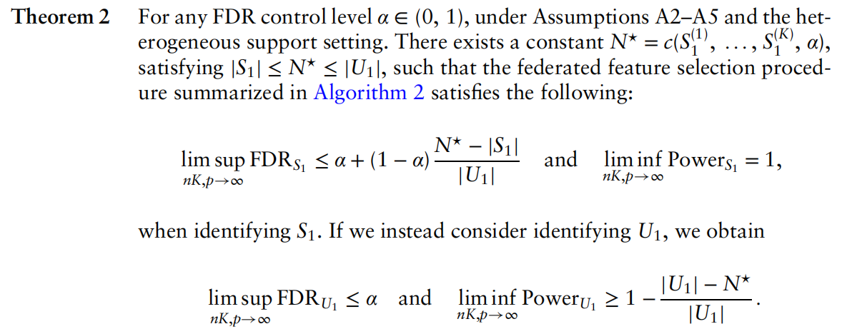


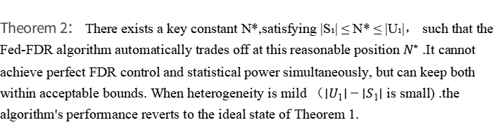
Theorem 2
Core conclusion：Fed-FDR remains effective in heterogeneous scenarios and provides precise statistical guarantees for different research objectives.
Essential Definition of N* ： It is the mathematical expectation of the total number of finally selected features after sorting by inclusion rate. Its value is jointly determined solely by the degree of data heterogeneity and the pre-specified significance level α The smaller the heterogeneity, the closer N* is to the size of the full support set; the larger the heterogeneity, the closer N* is to the size of the common support set.
Theorem 2
Objective A: Find a set of common feature S₁
conclusion：
FDR increases slightly, while power remains at 100%.
Objective B: Find the full set of features U₁
conclusion
Theorem 2： There exists a key constant N*,satisfying |S₁| ≤ N* ≤ |U₁|， such that the Fed-FDR algorithm automatically trades off at this reasonable position $N^{⋆}$ .It cannot achieve perfect FDR control and statistical power simultaneously, but can keep both within acceptable bounds. When heterogeneity is mild （$∣U_{1}∣−∣S_{1}∣$ is small) .the algorithm's performance reverts to the ideal state of Theorem 1.
FDR is strictly controlled, while power drops slightly.
Notes:
这就是我们的定理2，我先给大家念一下论文里的完整表述：存在一个由所有站点的支持集和我们预设的FDR水平α共同决定的常数N*，它介于共性支持集的大小和全局支持集的大小之间。接下来我们分两个目标来看。如果你的目标是找出所有医院都认可的最稳健的共性特征，那么定理2告诉你：你的功效是100%，也就是说你绝对不会漏掉任何一个共性特征；而FDR等于零特征带来的基础FDRα，加上一个特有特征带来的额外FDR。这个额外FDR非常小，完全由异质性程度决定。如果你的目标是找出所有可能相关的特征，不想漏掉任何潜在的科学发现，那么定理2告诉你：你的FDR依然会严格控制在α以内，绝对不会出现假阳性泛滥的情况；只是功效会有一个小幅的损失，这个损失也完全由异质性程度决定，只会漏掉那些只在一两个医院出现的极弱信号。

Slide 24



4.2 Model Misspecification
01 / Parameter Redefinition：
What is Model Misspecification？
Ideal Assumption：We typically assume the response variable$y_{ki}$ trictly follows an exponential family distribution, and construct the Generalized Linear Model (GLM) as the basis for statistical inference.
Dilemma：Real-world data often suffers from distribution shifts, outlier interference, or underlying nonlinear effects, causing systematic deviations between the pre-specified GLM structure and the true data generating mechanism.
注：f*True density; f: Assumed GLM working model density
When the model is misspecified, we no longer assume the data follows a specific exponential family distribution. Instead, we define the target parameter as the KL divergence minimizer—the parameter solution that minimizes the difference between the assumed model and the true data distribution. This is the core starting point of the Quasi-Maximum Likelihood Estimation (QMLE) framework.
Fatal Flaw of Traditional Methods
02 / Equivalence Proof：
Most classical high-dimensional feature selection methods are extremely sensitive to model misspecification. Even minor distributional deviations or incorrect model assumptions will lead to uncontrolled False Discovery Rate (FDR) and a sharp drop in statistical power. In non-ideal real-world data scenarios, the reliability and stability of these methods are significantly compromised, making them unable to meet the requirements of rigorous statistical inference.
Mathematical derivation shows that the first-order optimality condition for minimizing KL divergence is equivalent to solving the quasi-score equation. This equation is formally identical to the score equation of the standard GLM, meaning we can perform parameter estimation under the QMLE framework without modifying the original computational pipeline.
The quasi-score equation is formally identical to the GLM score equation
Notes:
接下来，我们讨论另一个更贴近现实的挑战：模型误设。我们在做分析时，通常会假设数据服从某个完美的统计模型，比如广义线性模型GLM。但真实世界的数据往往是“脏乱差”的，可能存在异常值，或者真实的关系并非线性。很多传统方法在这种情况下就会失效，导致假阳性率飙升。那么，我们的Fed-FDR方法在面对模型误设时，是否依然稳健？这是我们这一部分要回答的核心问题。

Slide 25
Empirical Validation
▍ Goals of Empirical Research
At the algorithm design and theoretical derivation level, we have demonstrated that Fed-FDR has four core theoretical advantages: strict FDR control, high statistical power, low communication cost, and robustness to heterogeneity. This empirical section focuses on answering two key questions through quantitative analysis:
Performance Validation: Theoretical Expectation vs. Actual Performance
Can Fed-FDR truly replicate the performance promises from theoretical analysis in non-asymptotic finite-sample scenarios? Rigorous quantitative comparisons with mainstream baseline methods are required.
Value Validation: Implementation Feasibility in Clinical Scenarios
Can Fed-FDR effectively resolve the contradiction between "data silos" and "privacy compliance" in real multi-party isolated clinical research collaborations, and produce high-value scientific results?
▍ Overall Framework of Empirical Research
01.Simulation Experiments：
Verify the algorithm's robustness and optimal parameter settings under different configurations
02. Real Clinical Data Application：
Validate the method's implementation value using long COVID data from 34 real medical sites
Notes:
“到这里，我们已经把Fed-FDR的算法设计、理论支撑全部介绍完了。接下来，我们进入实证验证部分，看看我们的方法在实际场景中，是不是真的能达到理论上的预期效果。我们的实证分为两大部分：第一部分是受控的仿真实验，我们在不同的参数设置下，量化对比Fed-FDR和各类基准方法的性能；第二部分是真实的临床数据应用，我们用34个临床站点的儿童新冠后遗症数据，验证方法的实际落地价值。”

Slide 26
Experimental Setup: Baseline Methods & Metrics
Comparative Baselines
Core Metrics
Data Generation
Empirical FDR (False Discovery Rate)
Def:Proportion of irrelevant features selected. Goal:Stably controlled belowα=0.1. Role:Measures false positive control.
1. BHq (Gold Standard):The upper bound in centralized setting. It computes p-values via desparsified Lasso and strictly controls FDR using the BHq procedure.
2. Meta-BHq:Each site calculates local p-values without sharing raw data. These p-values are aggregated and corrected with BHq.
3. Fed-FDR-N:Local sites use per-feature Lasso to build desparsified estimates, sent to the center for selection. The main federated baseline.
4. Fed-FDR-SCAD:A variant of our method that replaces the initial Lasso screening with SCAD penalty to test the impact of initial screening.
Basic Model: High-dimensional logistic regression (GLM) to simulate real biomedical binary outcomes.
Key Parameters: Target FDR level α=0.1. We analyze effects of signal strength, correlation, site count and sparsity.
Robustness: All results are averaged over 50 independent repetitions to ensure statistical reliability.
Statistical Power
Def:Proportion of true signals identified. Goal:Closer to 1 is better (stronger detection). Role:Measures true signal discovery.
Notes:
To validate our method, we designed comprehensive experiments. We compared Fed-FDR against several baselines, including the centralized gold standard (BHq), a common meta-analysis approach (Meta-BHq), and a naive federated implementation (Fed-FDR-N). We also tested a variant with a different screening method (Fed-FDR-SCAD). Our evaluation focused on two key metrics: empirical FDR and statistical power. We generated data using a high-dimensional logistic regression model and systematically varied parameters like signal strength and correlation. All results are averaged over 50 repetitions to ensure robustness.

Slide 27
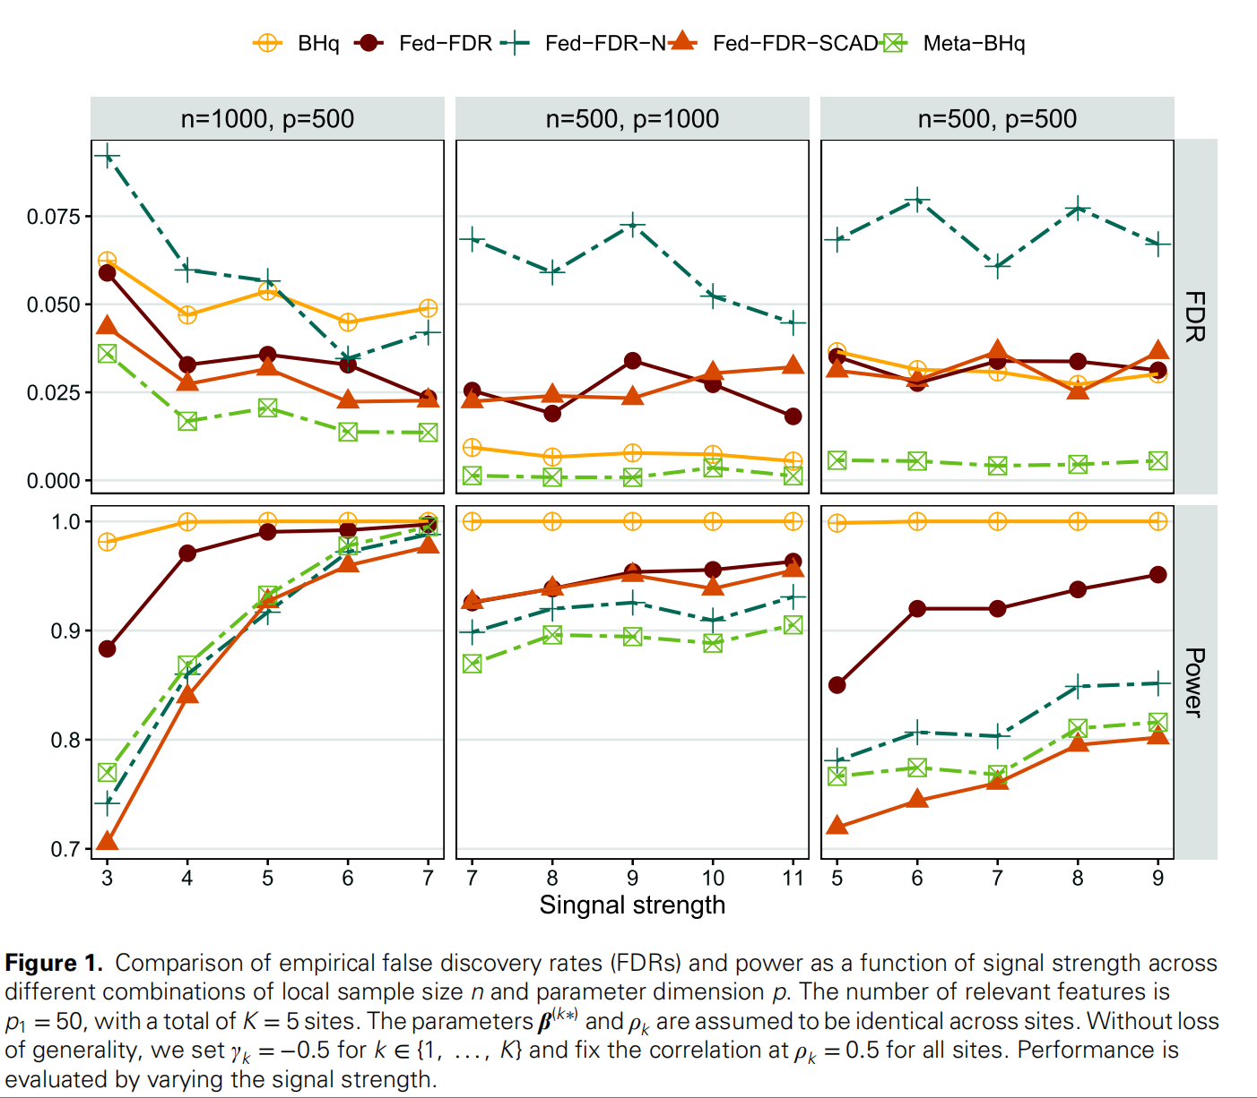
Simulation Results 1 | Performance under Varying Signal Strength
Fixed feature correlation (ρ=0.5), varying signal strength
01. Robust FDR Control
Across different signal strengths, the empirical FDR of all methods is stably controlled below the preset level of 0.1, showing good control performance. Among them, the FDR of Fed-FDR is extremely close to the gold standard BHq, almost identical, demonstrating strong robustness.
02. Significantly Leading Statistical Power
As signal strength increases, the Power of all methods continues to rise. Fed-FDR's Power consistently ranks first among all federated baseline methods and infinitely approaches the centralized gold standard BHq, significantly outperforming other comparison methods.
03. Core Value Perfectly Verified
Even in scenarios with relatively weak signal strength, Fed-FDR still achieves strict FDR control and the highest recognition ability, successfully fulfilling the core design goal of FDR controllability and high recognition.
Fed-FDR-N:Although Power is second, it requires running computationally explosive per-feature Lasso regression, transmits full-dimensional coefficients, has high cost, and the gap with Fed-FDR is large under weak signals.
Meta-BHq:Overly conservative, with very low Power throughout, sacrificing the vast majority of true positive identification capabilities for FDR control.
Fed-FDR-SCAD:Performs poorly under weak signals, prone to filtering out effective features, with Power lower than Fed-FDR.
Notes:
Our first simulation study examines performance as signal strength varies. The results are clear. First, all methods control FDR well, but Fed-FDR's FDR is nearly identical to the gold standard. Second, in terms of power, Fed-FDR is the clear leader among all federated methods and almost matches the centralized BHq. This advantage is most pronounced for weaker signals. The other methods show clear drawbacks: Fed-FDR-N is computationally expensive, Meta-BHq is too conservative, and Fed-FDR-SCAD struggles with weak signals.

Slide 28
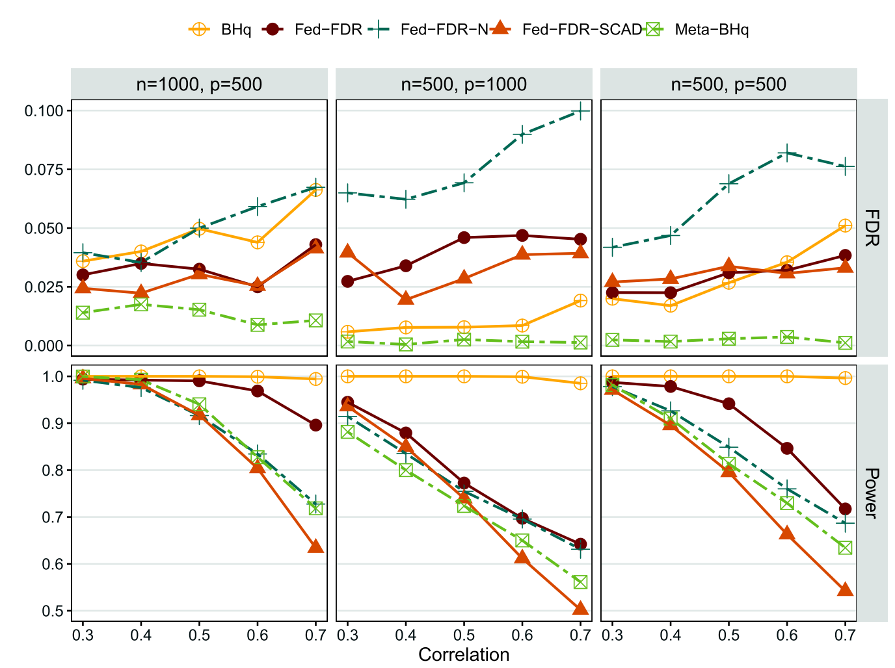
Simulation Results 2 | Performance under Varying Covariate Correlation
Fixed signal strength, varying feature correlation ρ (ρ=0.5)
Baseline: FDR Control is Compliant & Robust
All methods meet FDR≤0.1, but Fed-FDR-N's FDR approaches the red line (0.1) as collinearity strengthens. In contrast,Fed-FDR is far below the threshold, showing strong resistance to collinearity.
Performance: Screening Power Leads Competitors
All methods' Power declines with collinearity, but Fed-FDR consistently ranks 1st among federated methods, closest to the centralized gold standard BHq.
The left panel (n=1000/p=500/σ=4) shows the standard scenario; the middle panel (n=500/p=1000/σ=9) shows the high-dimensional, small-sample hard scenario; the right panel (n=500/p=500/σ=7) shows the medium-scale scenario. Different σ values are set to calibrate effective signal strength, avoid method failure, and ensure fair comparison across groups.
The upper panels show FDR (False Discovery Rate), which should be stably controlled below the red line of 0.1. The lower panels show Power (Statistical Power), where values closer to 1 indicate stronger ability to identify true features.
Conclusion: Ideal for Real Clinical Data
With differentiated p design to avoid extreme scenario bias, Fed-FDR maintains FDR control while achieving high screening power and robustness against collinear features, making it ideal for multi-center clinical data.
Notes:
Next, we tested performance under varying levels of feature correlation, a common challenge in real data. The results highlight the robustness of Fed-FDR. While other methods' FDR control starts to slip with high collinearity, Fed-FDR's FDR remains rock-solid. In terms of power, although all methods decline with increasing correlation, Fed-FDR maintains a significant lead over its competitors. This demonstrates that Fed-FDR is well-suited for the complex, correlated data found in real clinical settings.

Slide 29
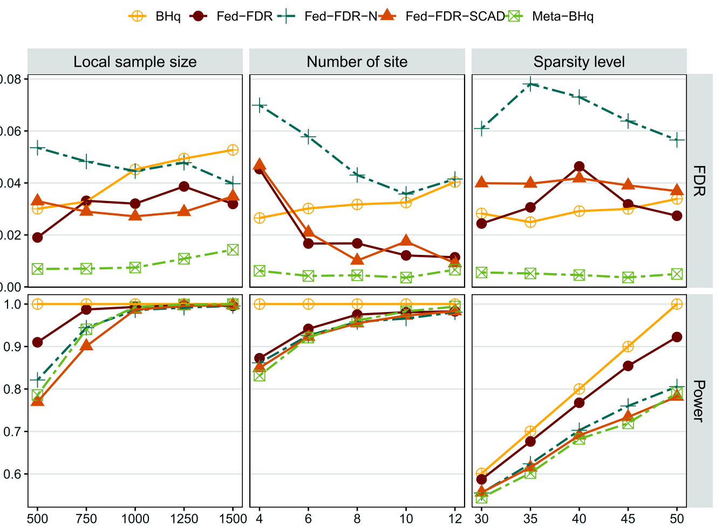
Simulation Results 3 | Impact of Sample Size, Number of Sites, and Sparsity
Impact of Local Sample Size
Impact of Number of Sites
Impact of Feature Sparsity
01. Robust FDR Control Performance
Under all settings of sample size, number of sites, and sparsity, the FDR of Fed-FDR is stably controlled within 0.1, without any out-of-control scenarios, demonstrating extremely strong robustness.
02. Excellent Statistical Power Performance
As local sample size and number of sites increase, Power rises rapidly and approaches 1, perfectly matching theoretical expectations. Even if the true feature sparsity decreases, it still maintains the best performance among federated methods.
03. Method Value Verification
The experiment verifies that Fed-FDR can maintain excellent and stable performance under all parameter combinations that may appear in real multi-center scenarios, fully demonstrating the dual reliability of the method in both theory and practice.
X-axis: Local Sample Size (n) Y-axis: Metric Value
X-axis: Number of Sites (K) Y-axis: Metric Value
X-axis: Sparsity Level (S) Y-axis: Metric Value
Notes:
We further investigated the impact of sample size, number of sites, and feature sparsity. The results consistently show that Fed-FDR maintains robust FDR control across all scenarios. Its power improves significantly with more samples and more sites, which is exactly what we expect from a federated method—it gets better as more data is added. This confirms that Fed-FDR is not just a theoretical construct but a practical and reliable tool for real-world multi-center studies.

Slide 30
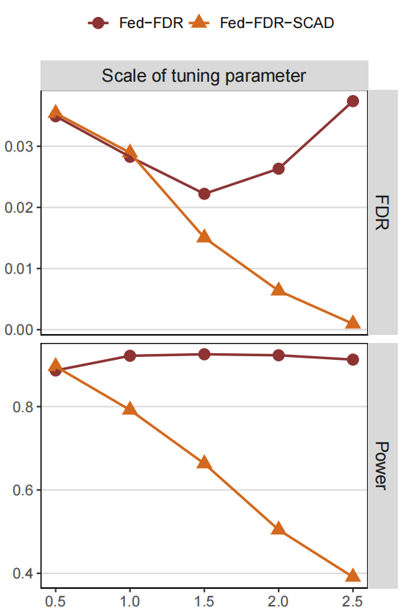
Supplementary Simulation Results | Tuning Robustness & Communication Cost
01 / Tuning Robustness Verification
02 / Communication Cost Quantification Comparison
Traditional Methods (Meta-BHq, Fed-FDR-N):Communication cost is proportional to the total feature dimension p, which is extremely high in high-dimensional biomedical data scenarios, making transmission costly.
Fed-FDR (This Study's Method):Communication cost is optimized to be proportional to the true relevant feature number p₁, drastically reducing data transmission.
Cost Reduction Effect: Assuming a high-dimensional scenario with p=10,000 and p₁=50, the communication overhead of Fed-FDR greatly reducing network and privacy computing costs for cross-center collaboration.
Notes:
Beyond performance, we also verified two practical aspects: tuning robustness and communication cost. Our method is highly robust to the choice of tuning parameters, meaning users don't need to spend hours fine-tuning to get good results. More importantly, our communication cost is dramatically lower than traditional methods. In a typical high-dimensional scenario, Fed-FDR reduces communication by over 99%, transmitting only 0.5% of the data volume. This makes it not only effective but also extremely efficient and practical for real-world deployment.

Slide 31

Real Data Application | Risk Factor Identification for Pediatric Post-Acute Sequelae of COVID-19 (PASC)
Data Source
Candidate Features
01 Research Background
Based on aggregated statistics from EHRs of 34 real clinical sites, a highly realistic dataset was generated, incorporating 3990 children aged 5-11, with an average of 130 per site.
A total of 243 multi-dimensional features were selected, covering: demographic characteristics, basic medical history, COVID-19 visit records, and related medication history.
Core Problem: Data Silos and Privacy Barriers
Pediatric electronic health records (EHR) are scattered across clinical sites and restricted by privacy laws, making traditional multi-center joint analysis impossible.
Study Outcome
Statistical Control
Research Goal: Feature Identification in a Federated Scenario
Without sharing raw data, use federated learning technology to identify common risk characteristics of PASC after Omicron infection in children across 34 clinical sites.
Focus on whether children develop allergic-related long-term COVID sequelae within 28-179 days after Omicron infection.
To balance false positives and false negatives, the preset FDR control level for multiple testing correction is α=0.1.
Notes:
To demonstrate real-world applicability, we applied Fed-FDR to a critical problem: identifying risk factors for pediatric long COVID (PASC). The setting perfectly illustrates the challenges of multi-center research: 34 sites with sensitive EHR data that cannot be shared. Our goal was to identify common risk factors across all sites without compromising privacy. We used a realistic dataset with 3990 children and 243 candidate features, focusing on allergic-related PASC as the outcome, with an FDR control level of 0.1.

Slide 32
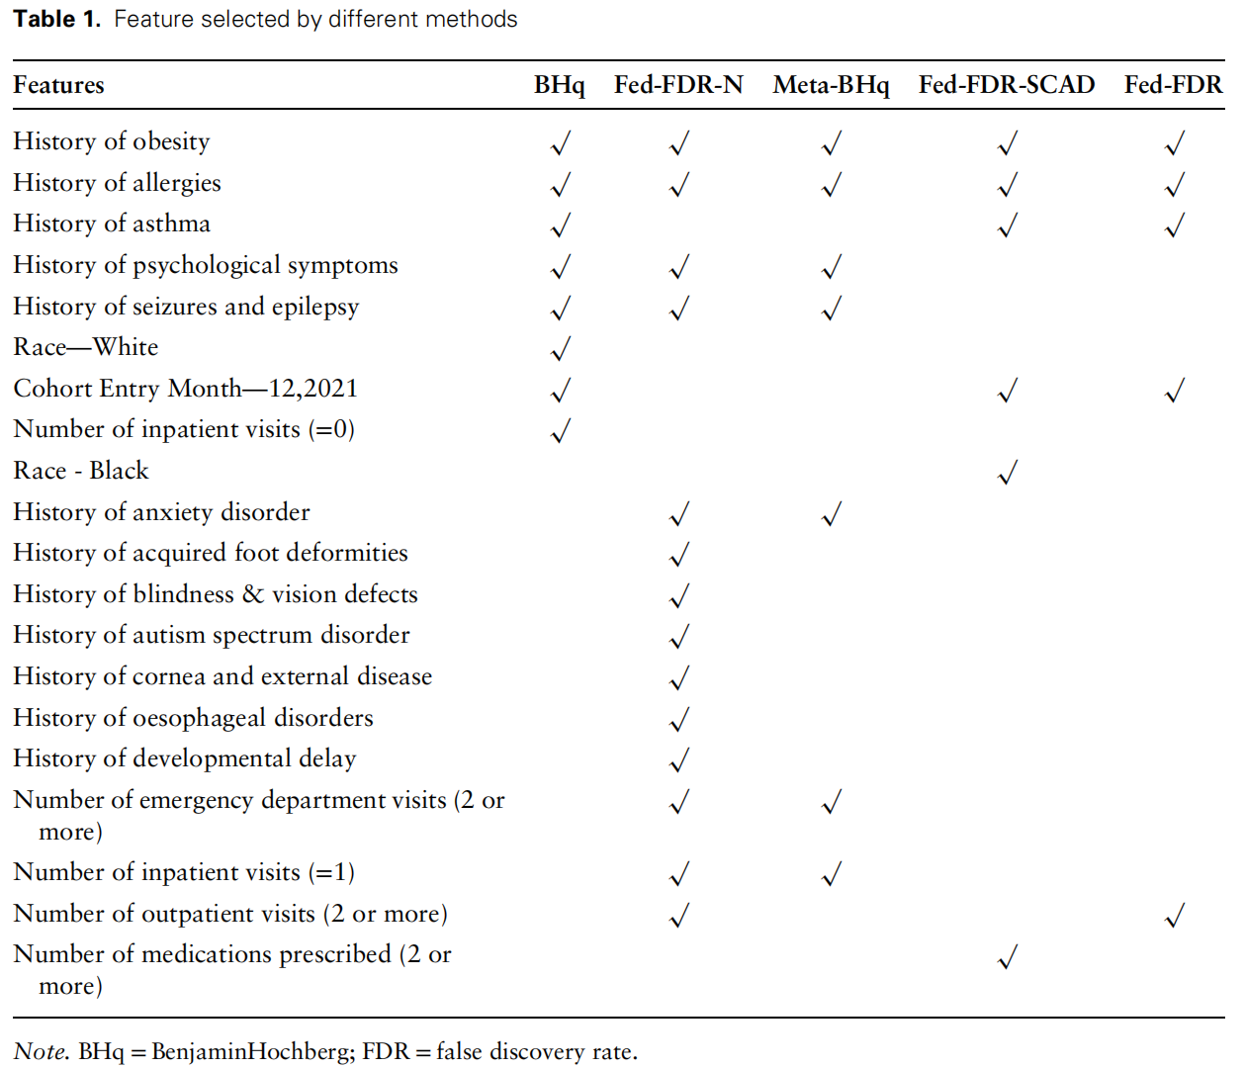
Real Data Application | Core Results and Clinical Value
Feature Selection Result Comparison
• Gold Standard BHq: Identified 8 statistically significant risk features.
• Fed-FDR:Successfully identified 4 of the 8 features, delivering the most reliable selection.
• Other Federated Methods:Only identified 4 gold-standard features and generated multiple false positives.
Core Risk Features Identified by Fed-FDR:
1. History of obesity | 2. History of allergies 3. History of asthma | 4. Cohort Entry Month
All four groups have been confirmed by adult PASC studies and have clear clinical basis.
Notes:
The results from the real data application are compelling. The centralized gold standard identified 8 significant features. Our Fed-FDR method identified 4 of these 8 features, and crucially, it had zero false positives. In contrast, other federated methods included several false positive features. The four features identified by Fed-FDR—obesity, allergies, asthma, and entry month—are all well-established risk factors for PASC in adults, demonstrating the clinical validity of our findings.

Slide 33
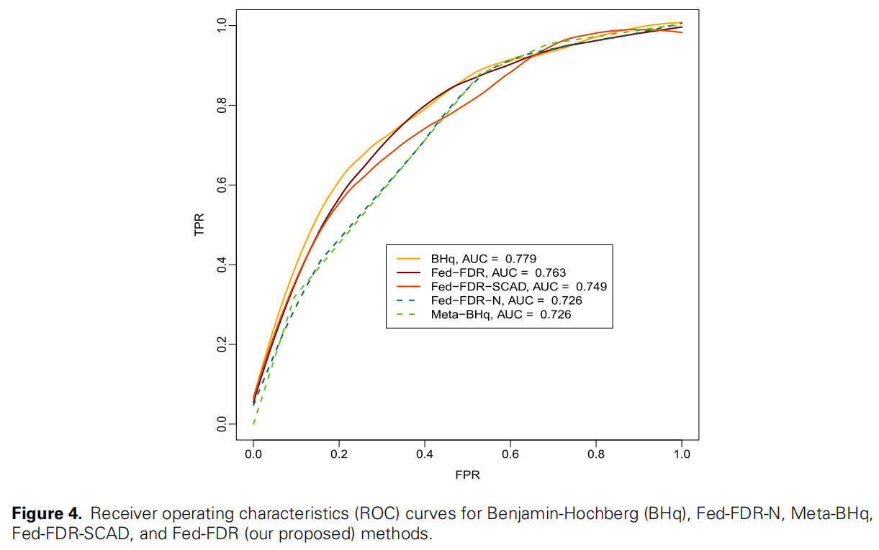

Real Data Application | Core Results and Clinical Value
Predictive Performance (AUC)
• Gold Standard BHq:AUC = 0.779
• Fed-FDR:AUC = 0.763(Infinitely close to GS)
• Other Federated Methods: AUC = 0.726 - 0.749
Clinical Value
Breakthrough in Privacy Computing Successfully extracted cross-institutional risk features without sharing any individual-level sensitive medical data.
Reliable & Clinically Meaningful The selected features align consistently with adult PASC study findings, and the predictive accuracy (AUC) closely approaches the centralized gold standard.
Notes:
We also evaluated the predictive performance using AUC. The gold standard achieved an AUC of 0.779. Fed-FDR achieved an AUC of 0.763, which is almost identical, despite using only 4 features and operating under strict privacy constraints. Other federated methods performed noticeably worse. This demonstrates the core clinical value of our approach: we can achieve results comparable to centralized analysis while fully protecting patient privacy, producing reliable and meaningful clinical insights.

Slide 34
Empirical Part | Overall Summary
Through simulation experiments and real clinical data applications, we have fully verified the actual performance of the Fed-FDR method. The core conclusions are as follows:
01
Stable FDR Control
In all scenarios, Fed-FDR can stably control FDR within the preset level, fully achieving the core design goal of the method.
02
Optimal Statistical Power
Among all federated baseline methods, the statistical power of Fed-FDR always ranks first, infinitely approaching the gold standard of centralized data.
Extremely Strong Landability
The method is insensitive to tuning, has extremely low communication costs, and is extremely robust to parameter changes such as feature correlation, sample size, and number of sites, adapting to various real application scenarios.
Clear Clinical Value
In real multi-center clinical research, Fed-FDR successfully identified risk factors with clear clinical significance under the premise of protecting data privacy, with reliable results that can be directly applied in practice.
03
04
Notes:
Let's summarize the empirical part. Our extensive simulations and real data application lead to four key conclusions. First, Fed-FDR provides stable and reliable FDR control. Second, it offers the highest statistical power among all federated methods tested. Third, it is highly practical, being robust to tuning and extremely efficient in terms of communication. Finally, and most importantly, it delivers clear clinical value by producing reliable, meaningful results in a real-world, privacy-preserving setting.

Slide 35
Core Technical Innovations
Inter-site Feature Exchange
Only feature indices and low-dimensional coefficients are exchanged, with raw data never leaving local sites. This drastically reduces communication costs and ensures privacy compliance.
01
Generalized Mirror Statistic
Proposes a cross-site pairwise generalized mirror statistic to achieve precise distributed FDR control. It leverages the natural independence between sites to ensure the symmetry of the null distribution.
02
Inclusion Rate Weighted Aggregation
Achieves adaptive threshold selection through global inclusion rate ranking. This mechanism automatically balances FDR control and statistical power, adapting to varying levels of data heterogeneity.
Theoretical Foundation
Provides rigorous theoretical guarantees for FDR control and statistical power under both ideal and heterogeneous scenarios, ensuring the method's validity and reliability.
03
04
Notes:
To summarize our work, I'd like to highlight the three core technical innovations of Fed-FDR. First, we proposed the Generalized Mirror Statistic, which allows us to control FDR in a distributed manner. Second, our Inter-site Feature Exchange mechanism ensures privacy and efficiency by only sharing a minimal amount of information. Third, the Inclusion Rate Weighted Aggregation strategy provides an adaptive way to balance FDR and power, making the method robust to different levels of data heterogeneity. Together, these innovations are supported by a solid theoretical foundation.

Slide 36



Conclusion: Fed-FDR Summary
Why Fed-FDR?
Key Takeaway
Fed-FDR provides a privacy-safe, statistically reliable, and computationally efficient unified feature selection framework for heterogeneous multi-center data, resolving the contradiction between "data silos" and rigorous inference.
Heterogeneity-Adaptive
Automatically adjusts to cross-site support set differences without pre-specified levels.
Robust to Misspecification
QMLE-based framework avoids strict exponential family distribution assumptions.
Future Work
• Extend to model free scenario
• Support nonlinear models
...
Application Areas
• Multi-center medical research • Biomarker discovery • Financial risk control • Cross-institutional data collaboration
Statistically Rigorous
Strict large-sample FDR control with power approaching the centralized BHq standard.
Fed-FDR bridges the gap between data privacy protection and the need for statistically sound inference in high-dimensional collaborative research.
Notes:
In conclusion, Fed-FDR stands out for its three key advantages: it is heterogeneity-adaptive, robust to model misspecification, and statistically rigorous. The key takeaway is that Fed-FDR offers a unified framework that is privacy-safe, statistically reliable, and computationally efficient, effectively bridging the gap between data privacy and rigorous analysis. Looking ahead, we plan to extend this work to vertical federated learning and nonlinear models. This method has broad applications in multi-center medical research, biomarker discovery, and beyond.

Slide 37

THANKS
感谢您的聆听 | 欢迎提问
Notes:
Thank you for your attention. I am happy to take any questions.

Slide 38
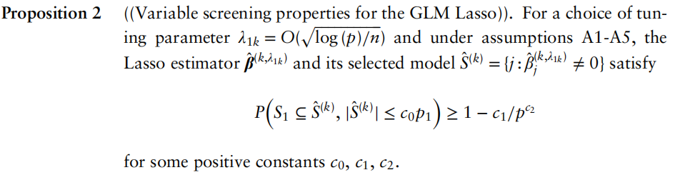
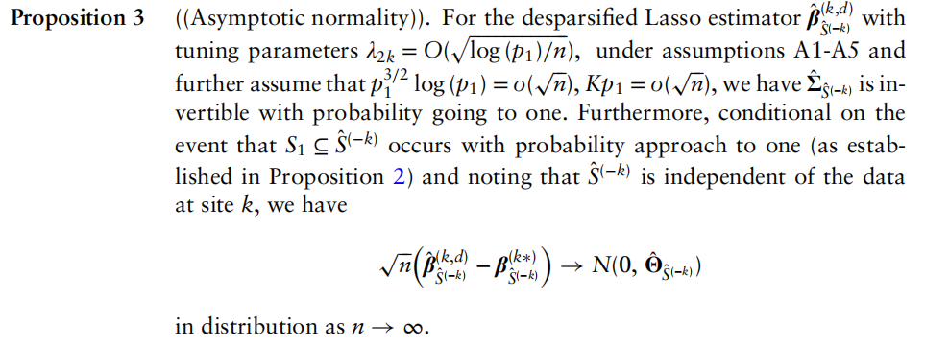
The Swap Strategy
Solving the Legitimacy Problem
Reducing Computational Complexity
Reducing Communication Costs
Problem:Feature selection + inference within one site leads to severe selection bias, breaking symmetry and inflating FDR.
Solution:Use the union of features fromother independent sitesfor inference, achieving full independence.
Problem:Traditional methods require p node-wise regressions, causing an explosion in computational load.
Solution:Low-dimensional matrices are full-rank and invertible, reducing cost from O(p²) to O(p₁²).
Problem:Debiased estimators are non-sparse, requiring transmission of the full p-dimensional vector.
Solution:Transmit only feature indices and low-dimensional coefficients, lowering cost to O(Kp₁).
Key Concept |  | Significance & Value
proposition2 |  | This separation fundamentally solves the selection bias problem and restores the validity of FDR control by preserving the statistical symmetry.
proposition3 |  | Enables practical application on high-dimensional data by avoiding node-wise regression. The lightweight communication protocol (sending indices only) makes it suitable for real-world distributed systems.
Notes:
Let's recap the benefits of our swap strategy. First, it solves the fundamental statistical problem of selection bias by ensuring independence between the features used for selection and inference.
Second, it drastically reduces computational complexity by working in a low-dimensional space, making the algorithm feasible even for very high p.
Third, it minimizes communication costs by only sharing a small set of feature indices and coefficients, which is crucial for real-world deployment.

